Slide 1
JavaBean
A JavaBean is a Java class that should follow the following conventions:
It should have a no-argument constructor.
It should be Serializable and which can implement the Serializable interface.
It should provide methods to set and get the values of the properties, known as getter and setter methods.

Slide 2
Example of JavaBean class
package mypack;
public class Employee implements java.io.Serializable{
private int id;
private String name;
public Employee(){}
public void setId(int id){this.id=id;}
public int getId(){return id;}
public void setName(String name){this.name=name;}
public String getName(){return name;}
}

Slide 3
Accessing JavaBean Class
To access the JavaBean class, we should use getter and setter methods.
package mypack;
public class Test{
public static void main(String args[]){
Employee e=new Employee();//object is created
e.setName(“Prabin"); //setting value to the object
System.out.println(e.getName()); //getting value of object
}}

Slide 4
Javabean Properties
A JavaBean property is a named feature that can be accessed by the user of the object.
The feature can be of any Java data type, containing the classes that you define.
A JavaBean property may be read, write, read-only, or write-only.
JavaBean features are accessed through two methods in the JavaBean's implementation class:
A read-only attribute will have only a getPropertyName() method, and a write-only attribute will have only a setPropertyName() method.

Slide 5
Contd…
1. getPropertyName ()
For example, if the property name is firstName, the method name would be getFirstName() to read that property.
This method is called the accessor.
2. setPropertyName ()
For example, if the property name is firstName, the method name would be setFirstName() to write that property.
This method is called the mutator.

Slide 6
Advantages Of JavaBean
The JavaBean properties and methods can be exposed to another application.
It provides an easiness to reuse the software components.
Disadvantages of JavaBean
JavaBeans are mutable.
So, it can't take advantages of immutable objects.
Creating the setter and getter method for each property separately may lead to the boilerplate code.

Slide 7
Accessing Javabeans In JSP
The useBean action declares a JavaBean for use in a JSP.
Once declared, the bean becomes a scripting variable that can be accessed by both scripting elements and other custom tags used in the JSP.
The full syntax for the useBean tag is as follows −
<jsp:useBean id= "instanceName" scope= "page | request | session | application"
class= "packageName.className" type= "packageName.className"
beanName="packageName.className | <%= expression >" >
</jsp:useBean>

Slide 8
Attributes And Usage Of Jsp:usebean Action Tag
id: is used to identify the bean in the specified scope.
scope: represents the scope of the bean in JSP page. It may be page, request, session or application.
page: specifies that you can use this bean within the JSP page. The default scope is page.
request: specifies the use bean from any JSP page that processes the same request. It has wider scope than page.
session: specifies the use bean from any JSP page in the same session whether processes the same request or not. It has wider scope than request.
application: specifies the use of bean from JSP page in the same application. It has wider scope than session.
class: instantiates the specified bean class (i.e. creates an object of the bean class) but it must have no-arg or no constructor and must not be abstract.

Slide 9
Contd…
type: provides the bean a data type if the bean already exists in the scope. It is mainly used with class or beanName attribute. If you use it without class or beanName, no bean is instantiated.
beanName: instantiates the bean using the java.beans.Beans.instantiate() method.

Slide 10
Example Of Jsp:usebean Action Tag
package com.javabean;
public class Calculator{
public int cube(int n){return n*n*n;}
}
index.jsp file
<jsp:useBean id="obj" class="com.javabean.Calculator"/>
<%
int m=obj.cube(5);
out.print("cube of 5 is "+m);
%>

Slide 11
Introspection
It is the process of analyzing a bean to determine its capabilities.
This is an essential feature of the java beans API because it allows another application, such as a design tool, to obtain information about a component
It is the automatic process of analyzing a bean's design patterns to reveal the bean's properties, events, and methods.
This process controls the publishing and discovery of bean operations and properties.
The way in which introspection is implemented provides great advantages, including:
Portability
Everything is done in the Java platform, so we can write components once, reuse them everywhere.

Slide 12
Contd…
There are no extra specification files that need to be maintained independently from our component code.
There are no platform-specific issues to contend with.
Your component is not tied to one component model or one proprietary platform.
You get all the advantages of the evolving Java APIs, while maintaining the portability of your components.
Reuse:
By following the JavaBeans design conventions, implementing the appropriate interfaces, and extending the appropriate classes, you provide your component with reuse potential that possibly exceeds your expectations.

Slide 13
Design Patterns For Properties
A property is a subset of a Bean’s state.
The values assigned to the properties determine the behavior and appearance of that component.
A property is set through a setter method.
A property is obtained by a getter method.
There are two types of properties: simple and indexed.

Slide 14
Simple Properties
A simple property has a single value.
It can be identified by the following design patterns, where N is the name of the property and T is its type:
public T getN( ) public void setN(T arg)
A read/write property has both of these methods to access its values.
A read-only property has only a get method. A write-only property has only a set method. Example:
private double depth;
public double getDepth( ) { return depth;}
public void setDepth(double d) { depth = d;}

Slide 15
Indexed Properties
An indexed property consists of multiple values.
It can be identified by the following design patterns, where N is the name of the property and T is its type:
public T getN(int index);
public void setN(int index, T value);
public T[ ] getN( );
public void setN(T values[ ]);

Slide 16
Example
Here is an indexed property called data along with its getter and setter methods:
private double data[ ];
public double getData(int index) { return data[index]; }
public void setData(int index, double value) { data[index] = value; }
public double[ ] getData( ) { return data; }
public void setData(double[ ] values) { data = new double[values.length];
System.arraycopy(values, 0, data, 0, values.length); }

Slide 17
Design Patterns For Events
Beans use the delegation event model that was discussed.
Beans can generate events and send them to other objects.
These can be identified by the following
public void addTListener(TListener eventListener)
public void addTListener(TListener eventListener)
throws java.util.TooManyListenersException
public void removeTListener(TListener eventListener)design patterns, where T is the type of the event:

Slide 18
Contd…
These methods are used to add or remove a listener for the specified event.
The version of addTListener( ) that does not throw an exception can be used to multicast an event, which means that more than one listener can register for the event notification.

Slide 19
Methods And Design Patterns
Design patterns are not used for naming nonproperty methods.
The introspection mechanism finds all of the public methods of a Bean.
Protected and private methods are not presented.

Slide 20
Using The Beaninfo Interface
As the preceding discussion shows, design patterns implicitly determine what information is available to the user of a Bean.
The BeanInfo interface enables you to explicitly control what information is available.
The BeanInfo interface defines several methods, including these:
PropertyDescriptor[ ] getPropertyDescriptors( ) EventSetDescriptor[ ] getEventSetDescriptors( ) MethodDescriptor[ ] getMethodDescriptors( )
They return arrays of objects that provide information about the properties, events, and methods of a Bean.
The classes PropertyDescriptor, EventSetDescriptor, and MethodDescriptor are defined within the java.beans package, and they describe the indicated elements.

Slide 21
Contd…
By implementing these methods, a developer can designate exactly what is presented to a user, bypassing introspection based on design patterns.

Slide 22
Bound And Constrained Properties
A Bean that has a bound property generates an event when the property is changed.
The event is of type PropertyChangeEvent and is sent to objects that previously registered an interest in receiving such notifications.
A class that handles this event must implement PropertyChangeListener interface.
A Bean that has a constrained property generates an event when an attempt is made to change its value.
It also generates an event of type PropertyChangeEvent.
It too is sent to objects that previously registered an interest in receiving such notifications.
However, those other objects have the ability to veto the proposed change by throwing a PropertyVetoException.

Slide 23
Persistence
Persistence is the ability to save the current state of a Bean, including the values of a Bean’s properties and instance variables, to nonvolatile storage and to retrieve them at a later time.
The object serialization capabilities provided by the Java class libraries are used to provide persistence for Beans.
The easiest way to serialize a Bean is to have it implement the java.io.Serializable interface, which is simply a marker interface.
Implementing java.io.Serializable makes serialization automatic.
Your Bean need take no other action. Automatic serialization can also be inherited.

Slide 24
Contd…
Therefore, if any superclass of a Bean implements java.io.Serializable, then automatic serialization is obtained.
When using automatic serialization, you can selectively prevent a field from being saved through the use of the transient keyword.
Thus, data members of a Bean specified as transient will not be serialized.
If a Bean does not implement java.io.Serializable, you must provide serialization yourself, such as by implementing java.io.Externalizable.
Otherwise, containers cannot save the configuration of your component.

Slide 25
Customizers
A Bean developer can provide a customizer that helps another developer configure the Bean.
A customizer can provide a step-by-step guide through the process that must be followed to use the component in a specific context.
Online documentation can also be provided.
A Bean developer has great flexibility to develop a customizer that can differentiate his or her product in the marketplace.

Slide 26
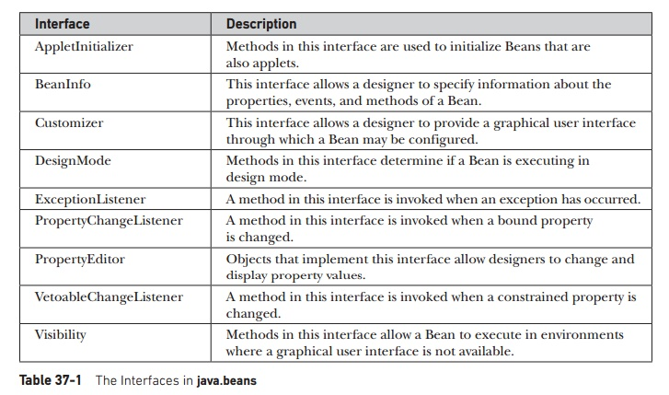

Slide 27
The Java Beans API
The package java.beans contains a set of classes and interfaces that provide many functionalities related to creating components based on JavaBeans architecture.
These classes are used by beans at runtime.
For example, the PropertyChangeEvent class is used to fire property and vetoable change events.
This enables beans to be saved in XML format.
The JavaBean APIs are meant to be used by the bean editor, which provides the environment to customize and manipulate the properties of a bean component

Slide 28
